Slide 1


AGRIBOT
ADVANCE MOBILE PHONE OPERATED MULTI PURPOSE AGRICULTURE ROBOTIC VEHICLE
GUIDE:
Mrs.N.Krishna Jyothi
Asst. Professor
Department of ECE
Batch C3:
Arisetty Sri Ramani (19251A04C3)
Gottipati Ashlesha (19251A04D2)
Manchina Roshini (19251A04E4)
Vanama Sahithi Jayaram (19251A04J0)

Slide 2
CONTENTS
INTRODUCTION
HARDWARE AND SOFTWARE REQUIREMENTS
BLOCK DIAGRAM
WORKING PRINCIPLE
ADVANTAGES and DISADVANTAGES
APPLICATIONS
KIT
RESULTS
CONCLUSION AND FUTURE SCOPE

Slide 3
INTRODUCTION
Agriculture is the backbone of India.
Some of the major problems in the Indian agricultural are rising of input costs, availability of skilled labors, lack of water resources and crop monitoring.
To overcome these problems, the automation technologies were used in agriculture.
The model development and the fabrication of the robot these whole systems of the robot works with the battery and power supply.

Slide 4
OBJECTIVES
To check the moisture content and taking necessary actions.
To plough the soil and cut the unwanted grass.
To help the farmers in ploughing.
To sow seeds.
To send update messages to farmer's mobile.

Slide 5
HARDWARE REQUIREMENTS
Arduino UNO
RPS (12V)
Humidity/ Soil Moisture Sensor
L293D Driver IC
DC Motors
Orcad Design
GSM module

Slide 6
SOFTWARE REQUIREMENTS
Arduino UNO
Software serial GPRS for Arduino

Slide 7
ARDUINO UNO
The Atmel AVR core combines a rich instruction set with 32 general-purpose working registers.
The ATmega328/P is supported with a full suite of program and system development tools including C Compilers, Macro Assemblers, Program Debugger/Simulators, In-Circuit Emulators, and Evaluation kits.
All 32 registers are directly connected to the Arithmetic Logic Unit

Slide 8
MOISTURE SENSOR
The Moisture sensor is used to measure the water content (moisture) of soil.
When the soil is having water shortage, the module output is at high level; else the output is at low level.
WATER MOTOR
This is a low cost, small size Submersible Pump Motor which can be operated from a 3 ~ 6V power supply.
It can take up to 120 liters per hour with very low current consumption of 220mA.

Slide 9
GSM MODULE
GSM is a cellular network, which means that mobile phones connect to it by searching for cells in the immediate vicinity.
.GSM-900 uses 890–915 MHz to send information from the mobile station to the base station (uplink) and 935–960 MHz for the other direction.
Time division multiplexing is used to allow eight full-rate or sixteen half-rate speech channels per radio frequency channel.

Slide 10
DC MOTOR
A dc motor uses electrical energy to produce mechanical energy, very generally through the interaction of magnetic fields and current-containing conductors.
The DC motor has two basic parts: the rotating part that is called the armature and the stable part that includes coils of wire called the field coils.

Slide 11
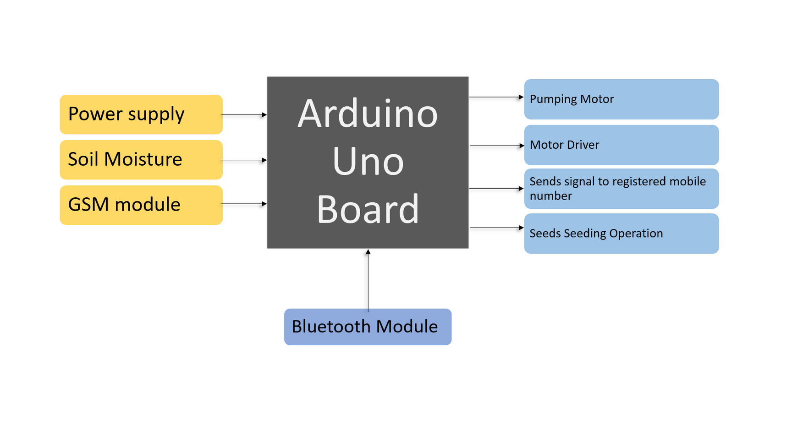
BLOCK DIAGRAM

Slide 12
WORKING PRINCIPLE
The basic idea of this project is to develop a multipurpose machine, which is used for ploughing the soil, and water sprayer to spray water with least changes in accessories with minimum cost.
This whole system of the robot works with the battery and the solar power.
Robot has rotor which will destroy the unwanted grasses while moving and also level the ground.
All the operations are performed with the help of PIC microcontroller.
Humidity sensor is used to sense the moisture content in the environment.

Slide 13
WORKING PRINCIPLE CONTD.
Moisture sensor is used to sense the water level in the ground and turn on and turn off the pumping motor depending on water level.
The GSM module is used to send the update messages to the user about the functioning of the robot.
The robot is also used for seed sowing by digging the soil at certain intervals and placing the seeds inside, and closing the soil.
.

Slide 14
ADVANTAGES
Reduces the number of labors required for agricultural activity.
Due to its quick action, time will be saved.
Agribot can able to work in any environmental condition.
The robots can work without sleep so they can work 24*7 for 365 days.
Protection against harmful effects of chemicals.

Slide 15
DISADVANTAGES
As machines will do all the work there will be less scope for employment of labor mainly in rural villages.
Robot needs high maintenance.
In a way or other emotional appeal of agriculture may be changed.

Slide 16
APPLICATIONS
Robot has rotor which will destroy the unwanted grasses while moving and also level the ground.
The robot also has a digger to dig the vegetables from the ground.
The robot automatically turn on and turn off of water pumping motor.

Slide 17
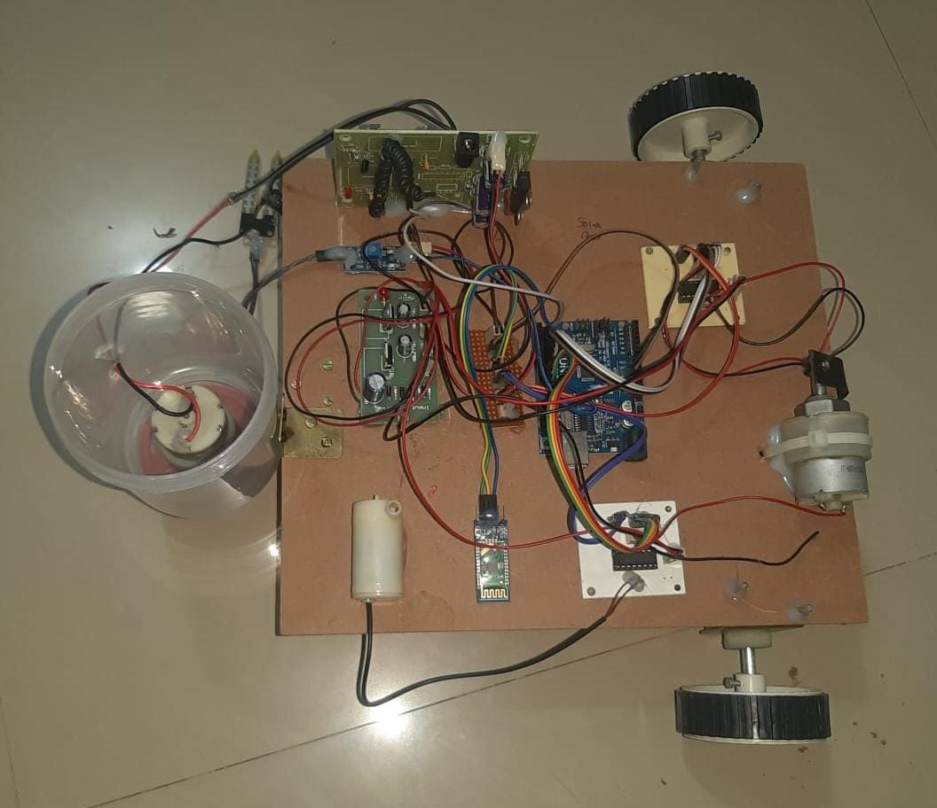
KIT

Slide 18
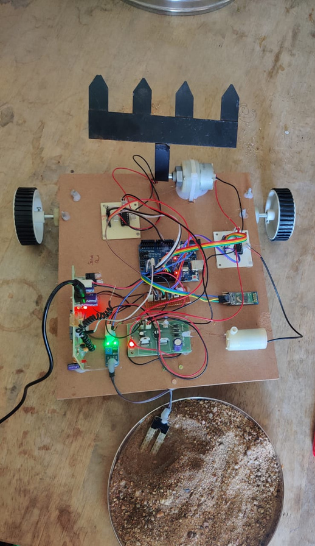
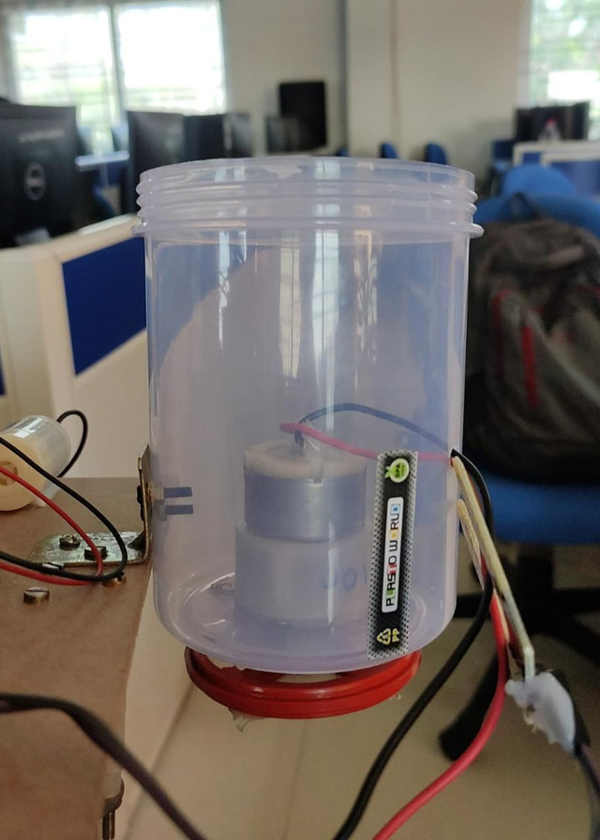
RESULTS

Slide 19
CONCLUSION AND FUTURE SCOPE
As ever increasing of world population and decreasing of agricultural workers created constraint to framing system.
Agricultural robot has potential to take off load of labor shortage and increasing the productivity.
Some activities like small scale irrigation, crop monitoring and seed sowing have been implemented so far.
The system can further modified for picking fruits, and actual cutting process by the system.

Slide 20
REFERENCES
Shibusawa, S. 1996. PhytoTechnology - An introduction to the concept and topic of a new Project. http://phytech.ishikawa?c.ac.jp/WhatIs.html.
Tillett, N.D., Hague, T. and Marchant, J.A.(1998) A robotic system for plant scale husbandry. Journal of Agricultural Engineering Research, 69, 169-178.
Blackmore, S. (2007). A systems view of agricultural robotics. Precision Agriculture conference, Wageningen Academic Publishers, the Netherlands. pp. 23-31

Slide 21

Thank You

